Slide 1

6th Grade Math
Unit 11, Lesson 7 Translating Real-World Written Descriptions into Algebraic Inequalities Volume 2, pg. 272

Slide 2



Benchmark
MA.6.AR.1.2
Translate a real-world written description into an algebraic inequality in the form of $x > a, x < a, x ≥ a,$ or $x ≤ a$. Represent the inequality on a number line.
volume 2, pg. 272

Slide 3
Integrated Mathematical Thinking and Reasoning Standards
MA.K12.MTR.1.1 Actively participate in effortful learning both individually and collectively.
MA.K12.MTR.4.1 Engage in discussions that reflect on the mathematical thinking of self and others.
MA.K12.MTR.5.1 Use patterns and structure to help understand and connect mathematical concepts.
MA.K12.MTR.6.1 Assess the reasonableness of solutions.
volume 2, pg. 272

Slide 4

Learning Targets
I can translate a written description into an algebraic inequality.
I can represent an inequality on a number line when given a written description of a real-world context.
volume 2, pg. 272

Slide 5

Warm-Up
volume 2, pg. 273

Slide 6
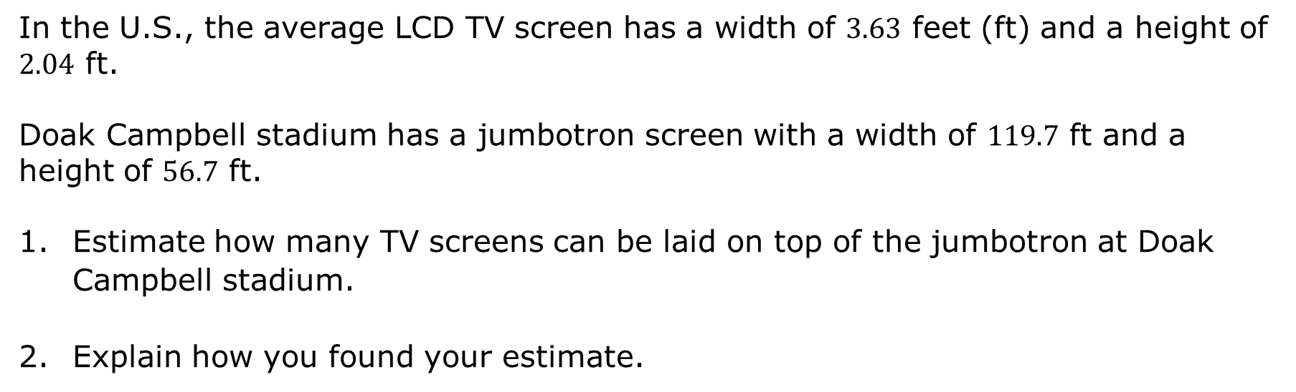
11.7.1 Warm-Up: Jumbotron Estimation
In the U.S., the average LCD TV screen has a width of $3.63$ feet (ft) and a height of $2.04$ ft.
Doak Campbell stadium has a jumbotron screen with a width of $119.7$ ft and a height of $56.7$ ft.
Estimate how many TV screens can be laid on top of the jumbotron at Doak Campbell stadium.
Explain how you found your estimate.
volume 2, pg. 273

Slide 7

Exploration
volume 2, pg. 273

Slide 8

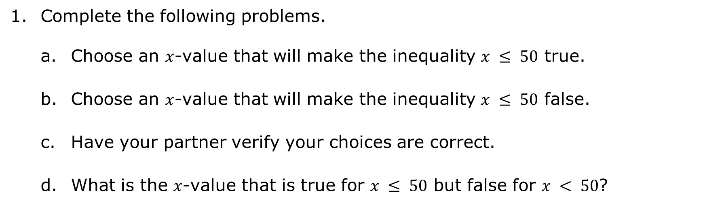
11.7.2 Exploration: Representing Inequalities on a Number Line
Complete the following problems.
Choose an $x$-value that will make the inequality $x ≤ 50$ true.
Choose an $x$-value that will make the inequality $x ≤ 50$ false.
Have your partner verify your choices are correct.
What is the $x$-value that is true for $x ≤ 50$ but false for $x < 50$?
volume 2, pg. 273

Slide 9
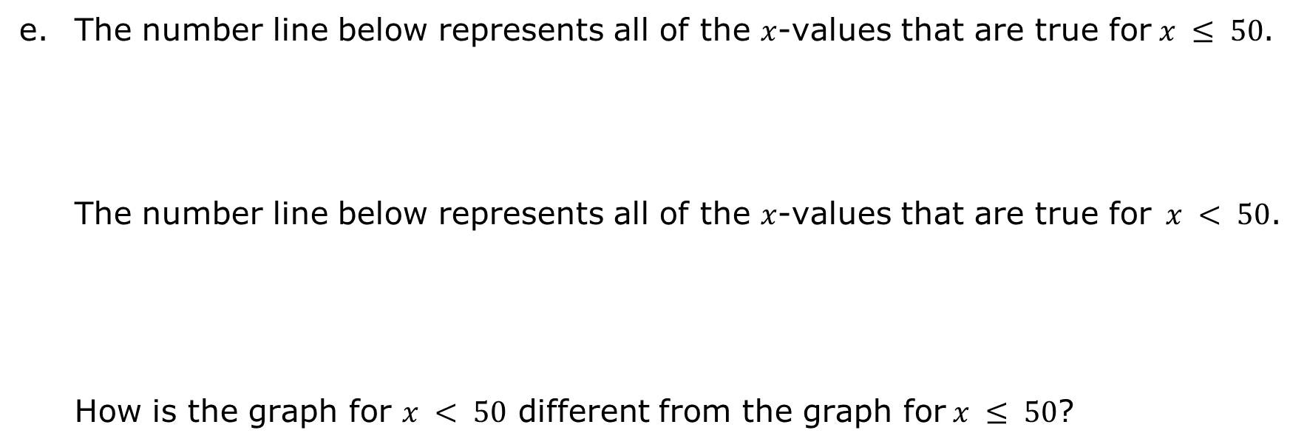
The number line below represents all of the $x$-values that are true for$x ≤ 50$.
The number line below represents all of the $x$-values that are true for$x < 50$.
How is the graph for $x < 50$ different from the graph for$x ≤ 50$?
volume 2, pg. 273

Slide 10


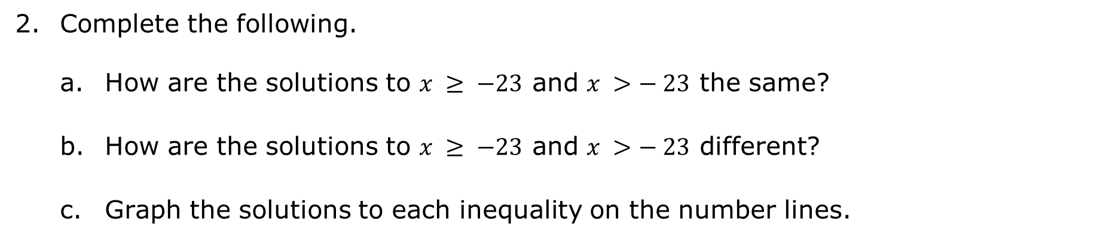
Complete the following.
How are the solutions to $x ≥ −23$ and $x >− 23$ the same?
How are the solutions to $x ≥ −23$ and $x >− 23$ different?
Graph the solutions to each inequality on the number lines.
$$x ≥ −23$$
$$x > −23$$
volume 2, pg. 274

Slide 11
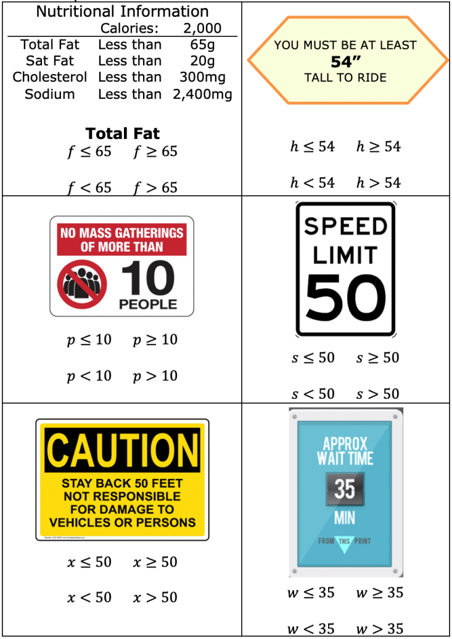
Complete the following.
With your partner, determine which inequality best represents each context.
volume 2, pg. 274

Slide 12
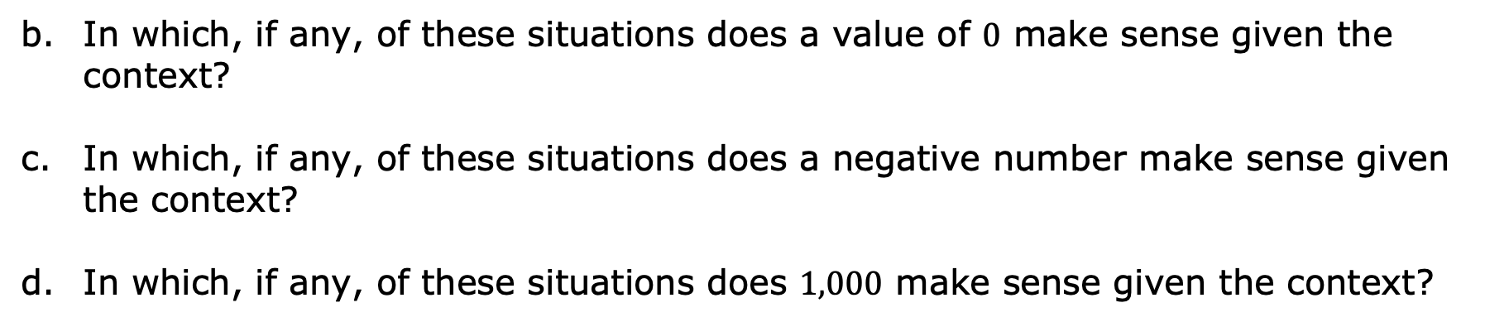
In which, if any, of these situations does a value of $0$ make sense given the context?
In which, if any, of these situations does a negative number make sense given the context?
In which, if any, of these situations does $1,000$ make sense given the context?
volume 2, pg. 275

Slide 13

Guided Practice
volume 2, pg. 275

Slide 14

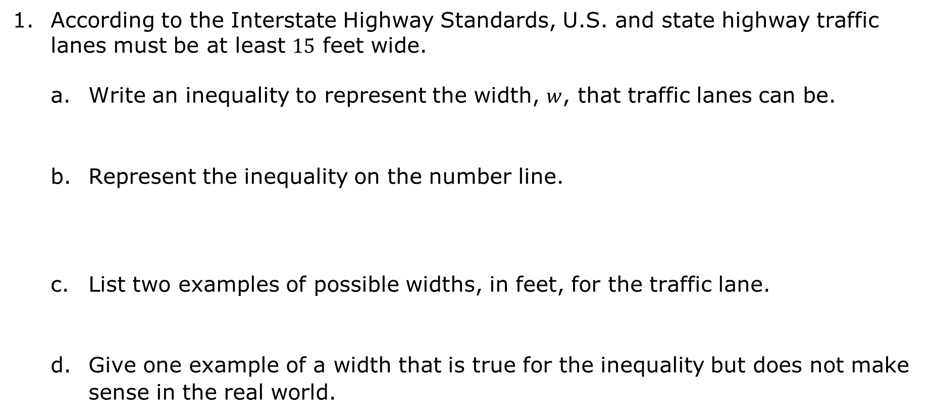
11.7.3 Guided Practice: Translating a Written Description into an Algebraic Inequality
According to the Interstate Highway Standards, U.S. and state highway traffic lanes must be at least $15$ feet wide.
Write an inequality to represent the width, $w$, that traffic lanes can be.
Represent the inequality on the number line.
List two examples of possible widths, in feet, for the traffic lane.
Give one example of a width that is true for the inequality but does not make sense in the real world.
volume 2, pg. 275

Slide 15
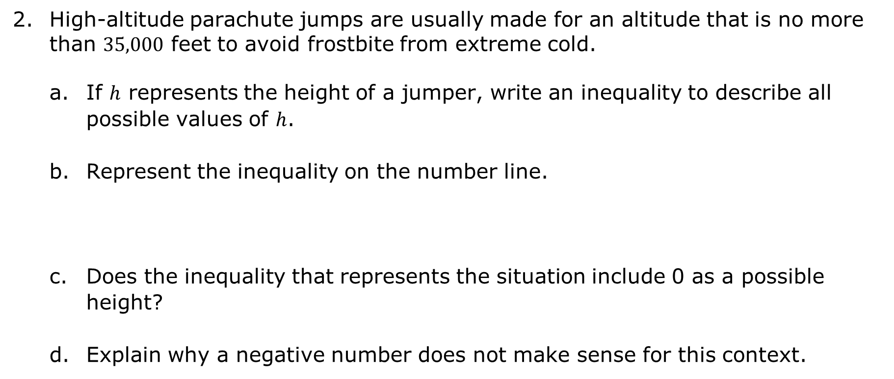
High-altitude parachute jumps are usually made for an altitude that is no more than $35,000$ feet to avoid frostbite from extreme cold.
If $h$ represents the height of a jumper, write an inequality to describe all possible values of $h$.
Represent the inequality on the number line.
Does the inequality that represents the situation include 0 as a possible height?
Explain why a negative number does not make sense for this context.
volume 2, pg. 276

Slide 16

Try It
volume 2, pg. 276

Slide 17

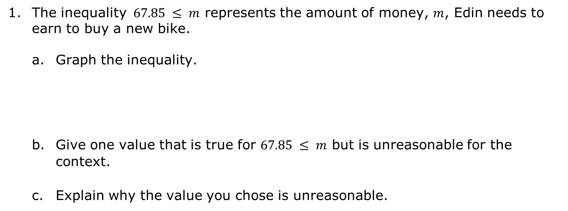
11.7.4 Try It: Writing an Algebraic Inequality and Representing It on a Number Line
The inequality $67.85 ≤ m$ represents the amount of money, $m$, Edin needs to earn to buy a new bike.
Graph the inequality.
Give one value that is true for $67.85 ≤ m$ but is unreasonable for the context.
Explain why the value you chose is unreasonable.
volume 2, pg. 276

Slide 18
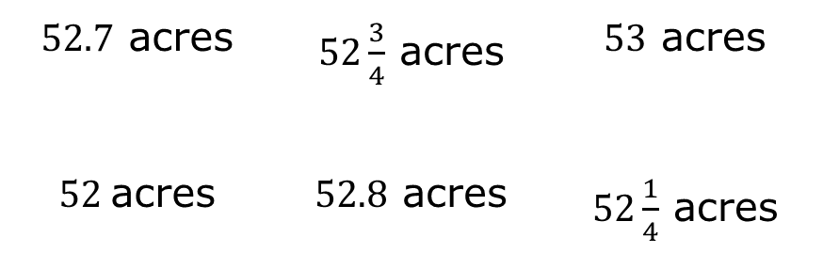
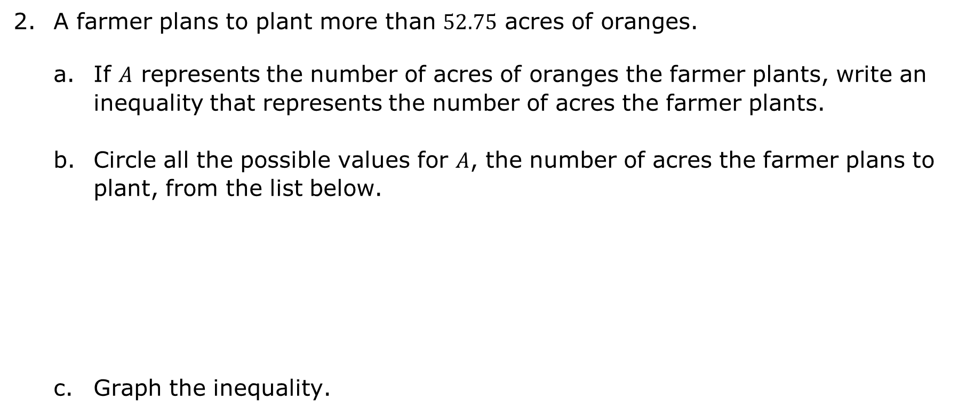
A farmer plans to plant more than $52.75$ acres of oranges.
If $A$ represents the number of acres of oranges the farmer plants, write an inequality that represents the number of acres the farmer plants.
Circle all the possible values for $A$, the number of acres the farmer plans to plant, from the list below.
Graph the inequality.
$52.7$ acres | $52\frac{3}{4}$ acres | $53$ acres
$52$acres | $52.8$ acres | $52\frac{1}{4}$ acres
volume 2, pg. 277

Slide 19

Your Turn
volume 2, pg. 277

Slide 20
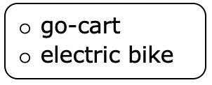
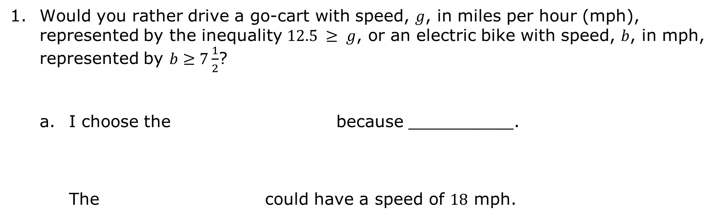
11.7.5 Your Turn!
Would you rather drive a go-cart with speed, $g$, in miles per hour (mph), represented by the inequality $12.5 ≥ g$, or an electric bike with speed, $b$, in mph, represented by $b≥7\frac{1}{2}$?
I choose the because __________. The could have a speed of $18$ mph.
volume 2, pg. 277

Slide 21
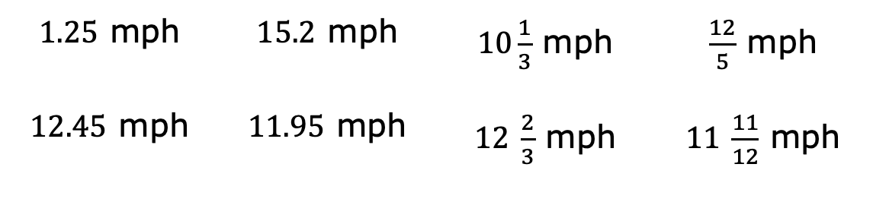
Circle all the values from the list below that are possible speeds for the go-cart.
$1.25$ mph | $15.2$ mph | $10\frac{1}{3}$ mph | $\frac{12}{5}$ mph
$12.45$ mph | $11.95$ mph | $12$ $\frac{2}{3}$ mph | $11$ $\frac{11}{12}$ mph
volume 2, pg. 277

Slide 22
Represent the speed of the electric bike on the number line.
Represent the speed of the go-cart on the number line.
Explain why the number lines do not include negative numbers.
volume 2, pg. 278

Slide 23

Wrap-Up
volume 2, pg. 278

Slide 24
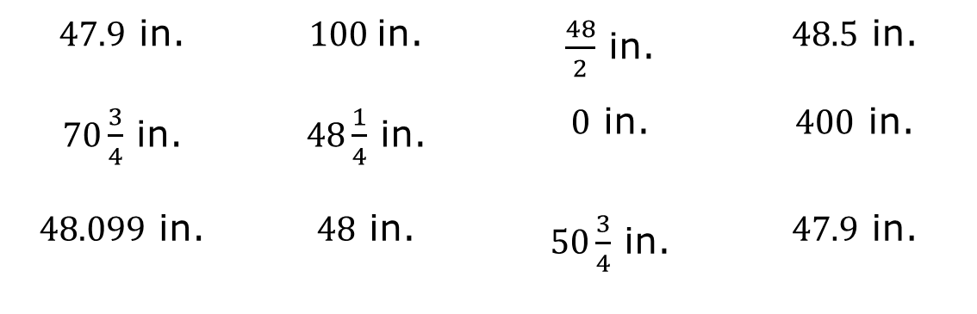
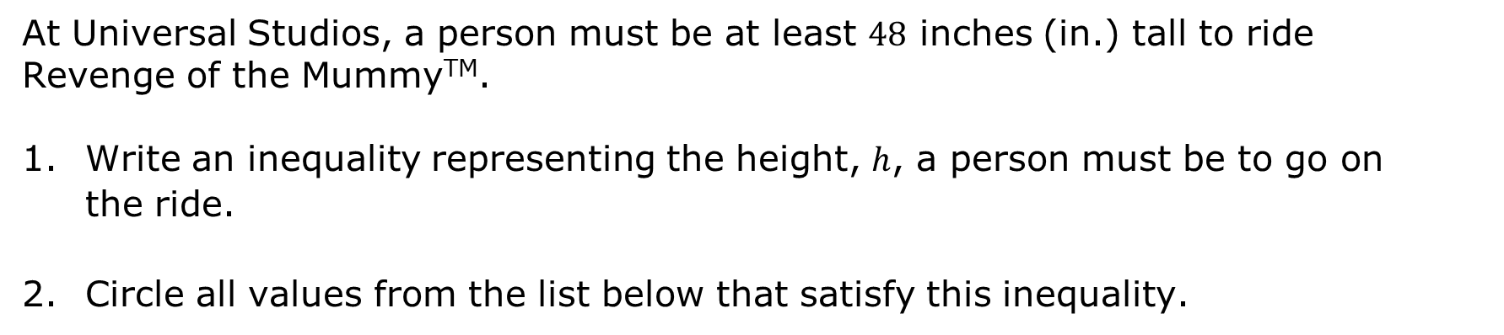
11.7.6 Wrap-Up: Ticket Out the Door
At Universal Studios, a person must be at least $48$ inches (in.) tall to ride Revenge of the MummyTM.
Write an inequality representing the height, $h$, a person must be to go on the ride.
Circle all values from the list below that satisfy this inequality.
$47.9$ in. | $100$in. | $\frac{48}{2}$ in. | $48.5$ in.
$70\frac{3}{4}$ in. | $48\frac{1}{4}$ in. | $0$ in. | $400$ in.
$48.099$ in. | $48$ in. | $50\frac{3}{4}$ in. | $47.9$ in.
volume 2, pg. 278

Slide 25
Graph the inequality on the number line.
volume 2, pg. 278

